Slide 1
Identifying neutrons in LArTPC-based neutrino oscillation experiments
Identifying neutrons in LArTPC experiments prevents biasing of neutrino energy reconstruction
In order to identify neutrons signature in LArTPC, we will use the light signature they produce in the detector
Current detectors like DUNE only have enough coverage of light detectors for trigger purposes
We will calculate the light coverage needed for neutron identification based on single elastic interaction in LAr

Slide 2
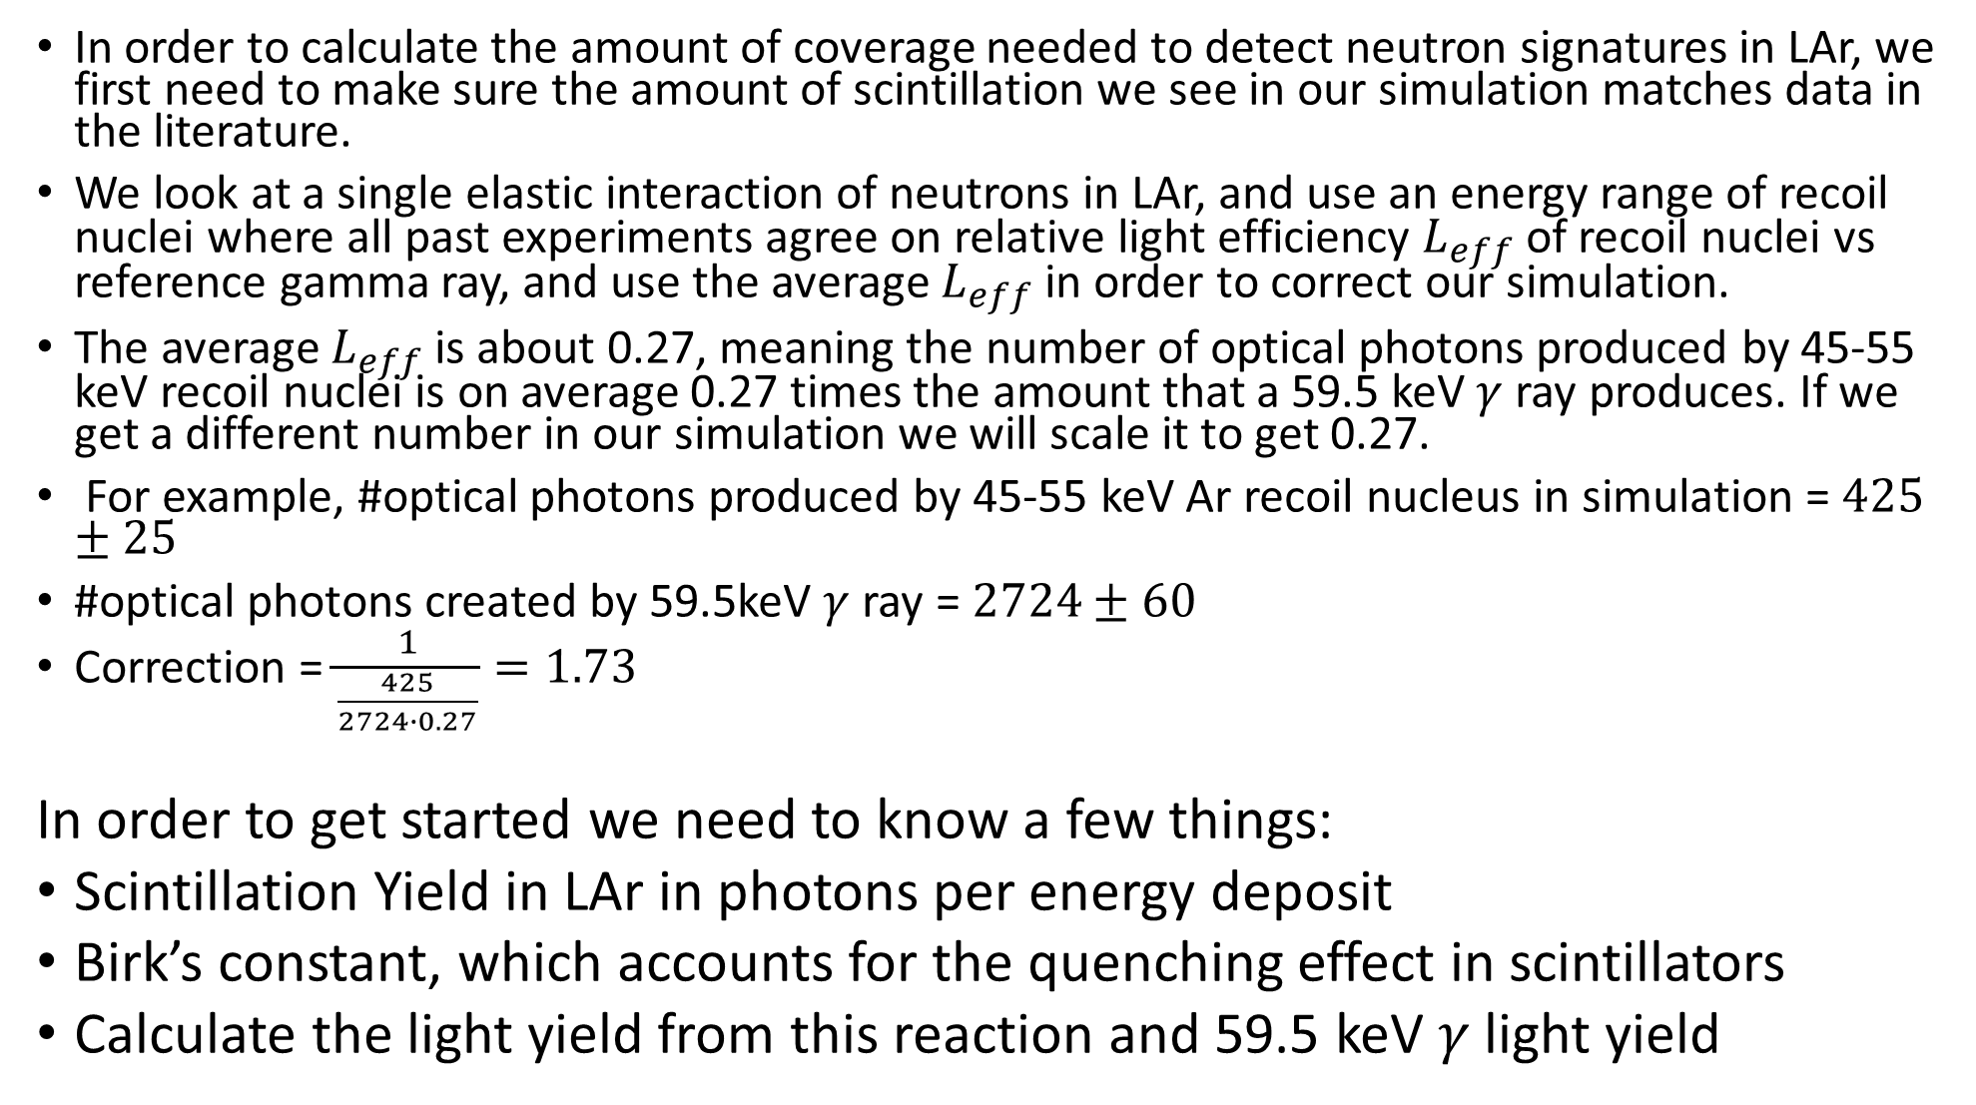
In order to calculate the amount of coverage needed to detect neutron signatures in LAr, we first need to make sure the amount of scintillation we see in our simulation matches data in the literature.
We look at a single elastic interaction of neutrons in LAr, and use an energy range of recoil nuclei where all past experiments agree on relative light efficiency $L_{eff}$of recoil nuclei vs reference gamma ray, and use the average $L_{eff}$in order to correct our simulation.
The average $L_{eff}$ is about 0.27, meaning the number of optical photons produced by 45-55 keV recoil nuclei is on average 0.27 times the amount that a 59.5 keV $γ$ ray produces. If we get a different number in our simulation we will scale it to get 0.27.
For example, #optical photons produced by 45-55 keV Ar recoil nucleus in simulation = $425±25$
#optical photons created by 59.5keV $γ$ ray = $2724±60$
Correction = $\frac{1}{\frac{425}{2724∙0.27}}=1.73$
In order to get started we need to know a few things:
Scintillation Yield in LAr in photons per energy deposit
Birk’s constant, which accounts for the quenching effect in scintillators
Calculate the light yield from this reaction and 59.5 keV $γ$ light yield

Slide 3
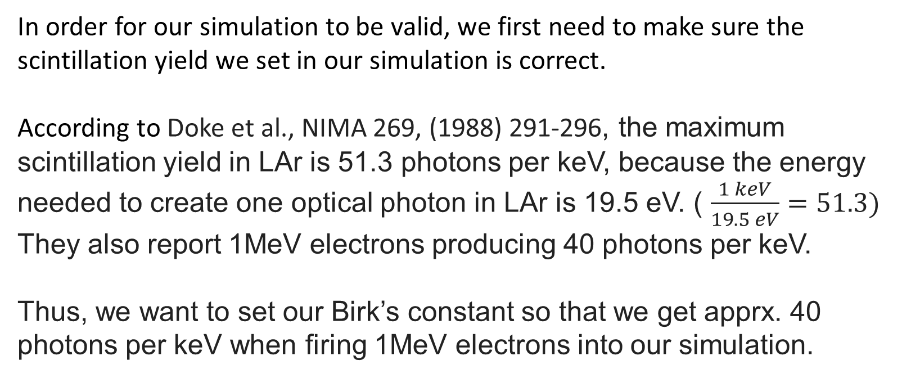
In order for our simulation to be valid, we first need to make sure the scintillation yield we set in our simulation is correct.
According to Doke et al., NIMA 269, (1988) 291-296, the maximum scintillation yield in LAr is 51.3 photons per keV, because the energy needed to create one optical photon in LAr is 19.5 eV. ( $\frac{1 keV}{19.5 eV}=51.3)$
They also report 1MeV electrons producing 40 photons per keV.
Thus, we want to set our Birk’s constant so that we get apprx. 40 photons per keV when firing 1MeV electrons into our simulation.

Slide 4
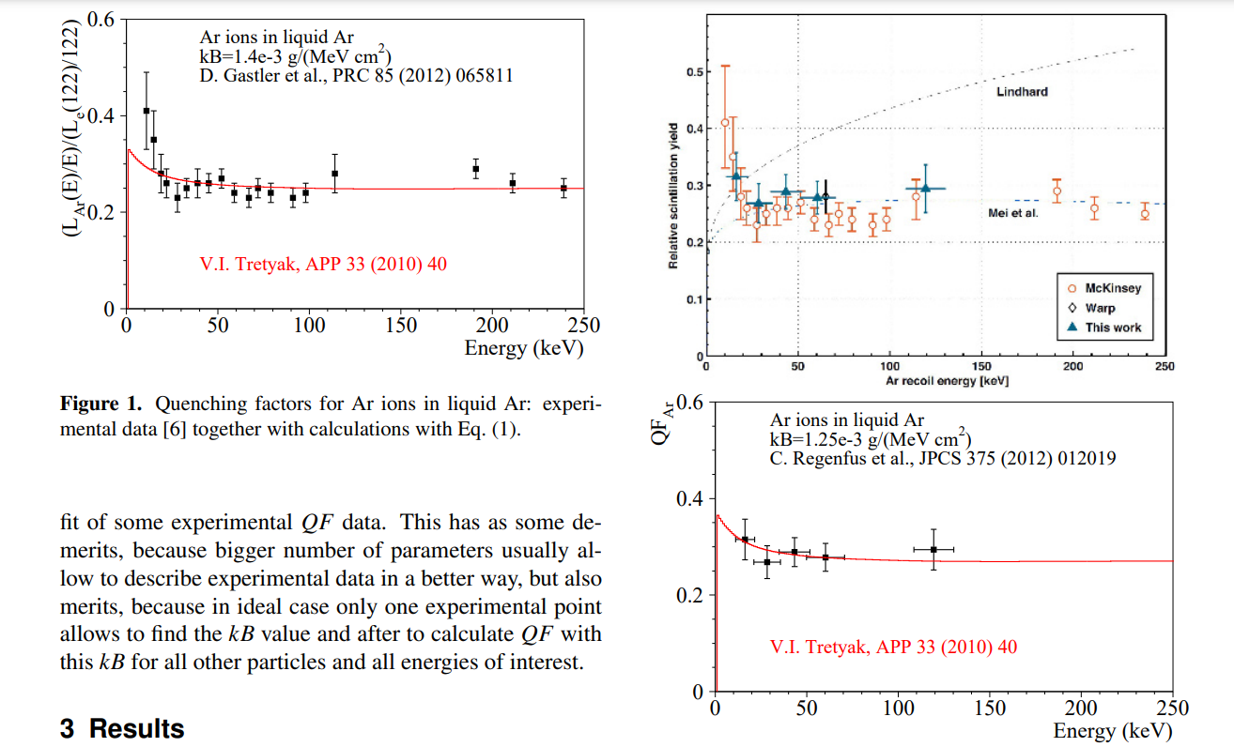
https://www.epj-conferences.org/articles/epjconf/pdf/2014/02/epjconf_rpsc2013_02002.pdf

Slide 5
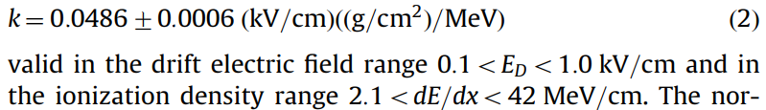
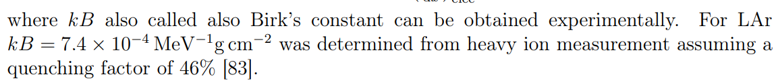
ICARUS found: [https://www.sciencedirect.com/science/article/pii/S0168900204000506]
Creus reports: [http://unizh.web.cern.ch/Publications/Articles/thesis_William.pdf]

Slide 6

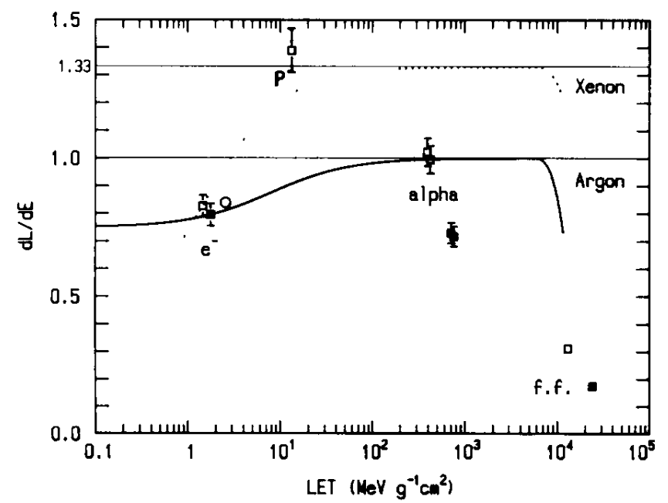
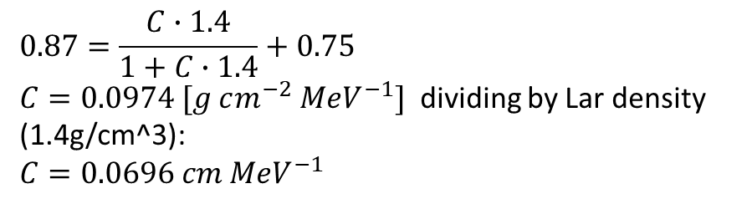
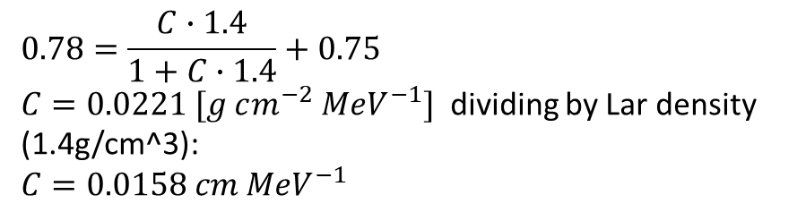
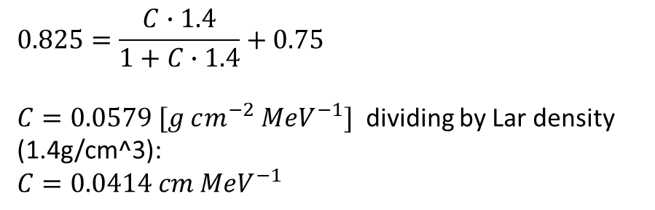
1 MeV electrons produce $4.0∙{10}^{4} (±10\%)photons per MeV$
Doke et al., NIMA 269, (1988) 291-296
Extracting Birk’s coefficient kB (C in his paper) using Doke et al.’s data:
Doke et al., NIMA 291 (1990) 617-620
$$0.825=\frac{C∙1.4}{1+C∙1.4}+0.75$$
$C=0.0579 [g cm^{−2} MeV^{−1}]$ dividing by Lar density (1.4g/cm^3):
$$C=0.0414 cm MeV^{−1}$$
$$0.78=\frac{C∙1.4}{1+C∙1.4}+0.75$$
$C=0.0221 [g cm^{−2} MeV^{−1}]$ dividing by Lar density (1.4g/cm^3):
$$C=0.0158 cm MeV^{−1}$$
$$0.87=\frac{C∙1.4}{1+C∙1.4}+0.75$$
$C=0.0974 [g cm^{−2} MeV^{−1}]$ dividing by Lar density (1.4g/cm^3):
$$C=0.0696 cm MeV^{−1}$$
$$C=kB={0.0414}_{−0.256}^{+282}[cm MeV^{−1}]$$

Slide 7
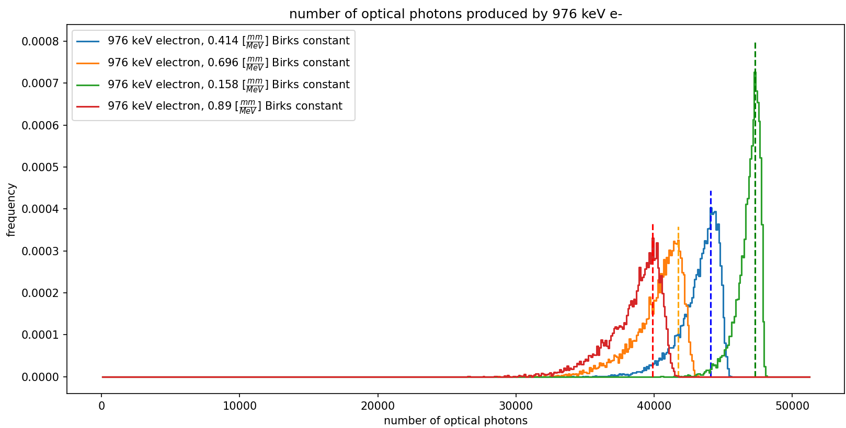
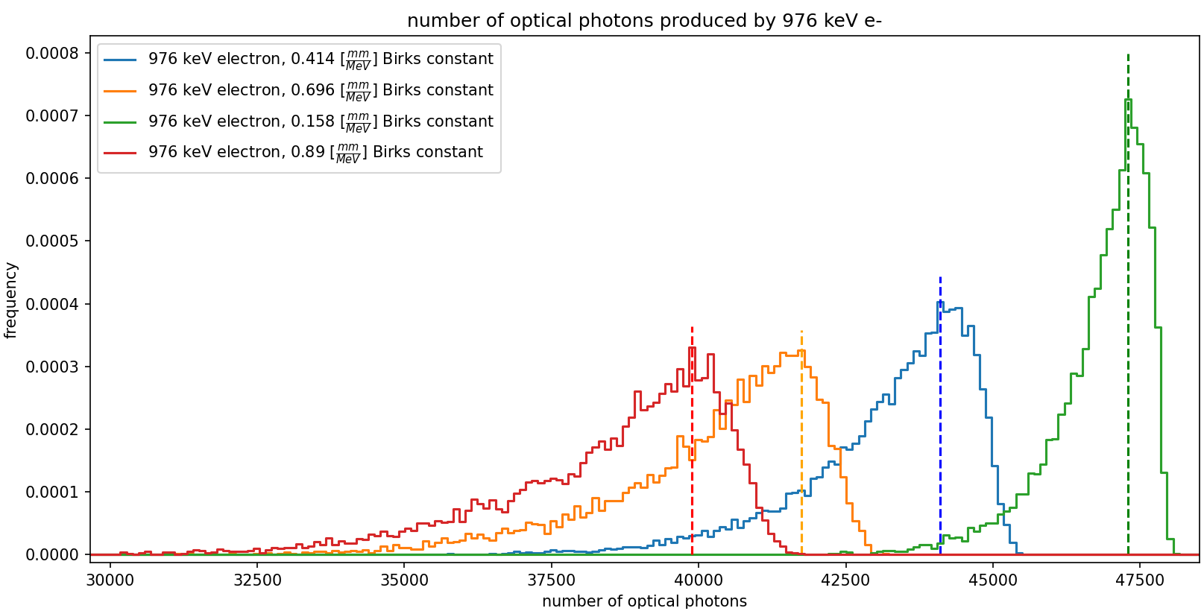

Slide 8
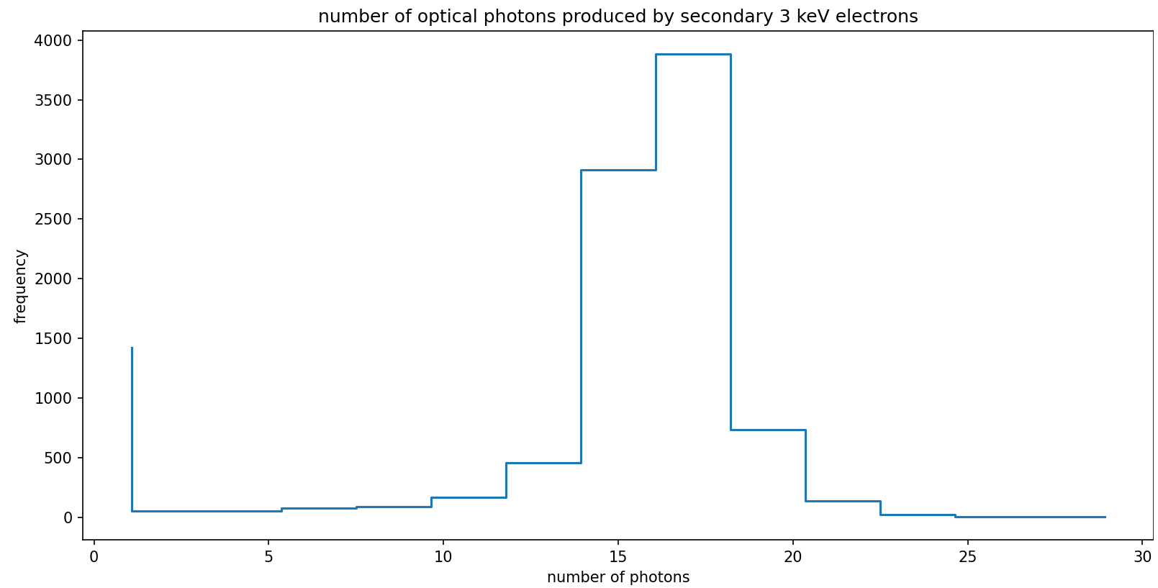

Slide 9
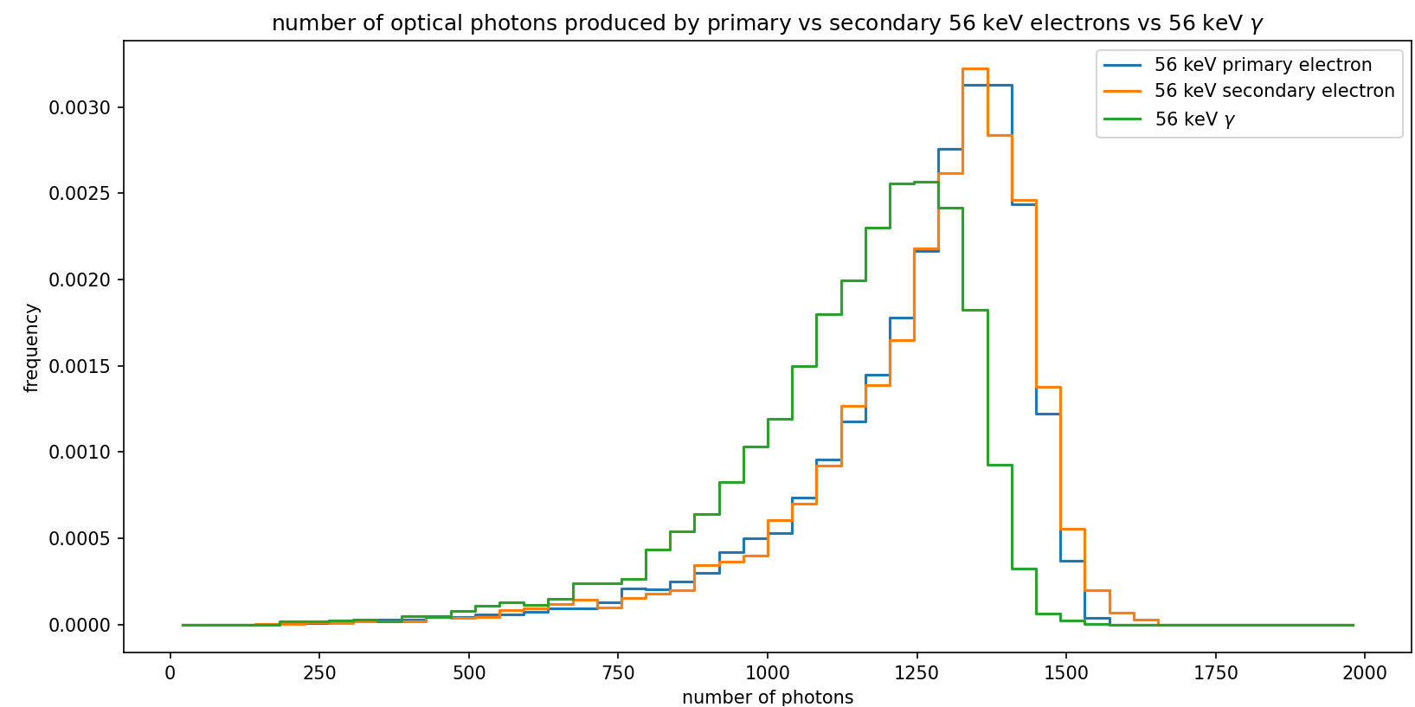

Slide 10
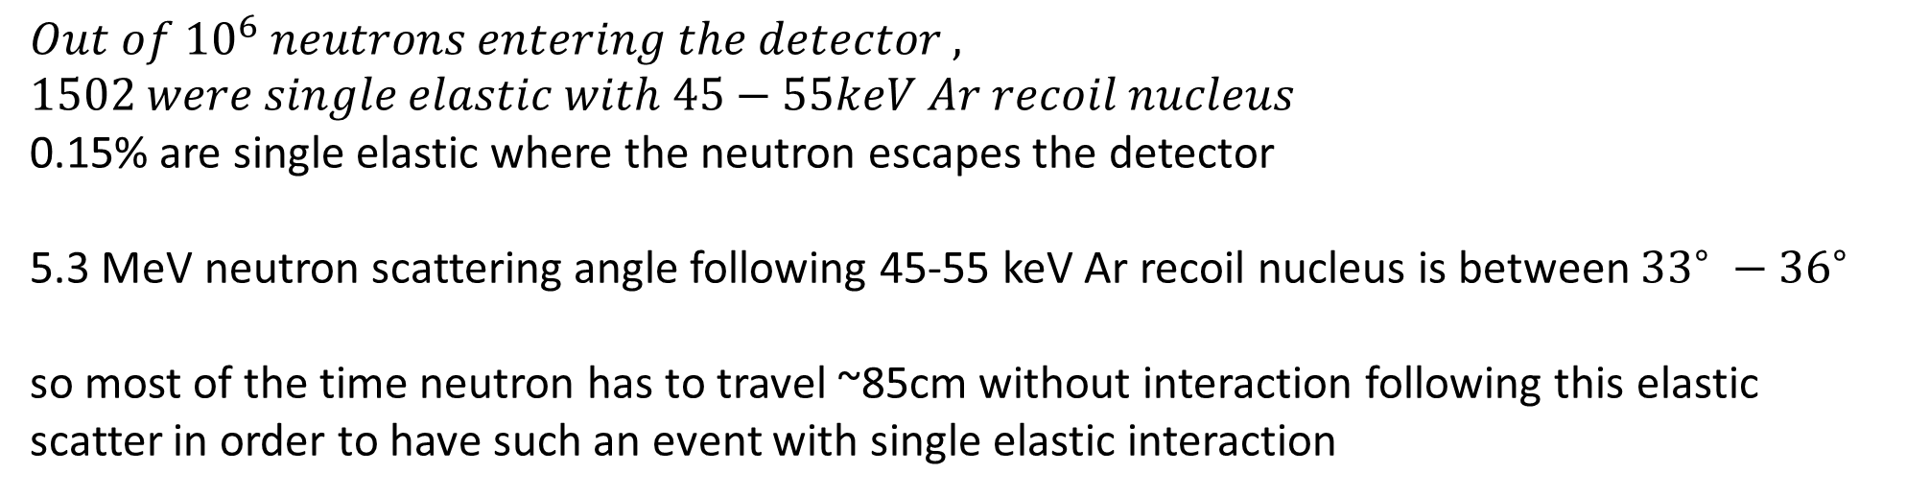
$$Out of {10}^{6} neutrons entering the detector ,$$
$$1502 were single elastic with 45−55keV Ar recoil nucleus$$
0.15% are single elastic where the neutron escapes the detector
5.3 MeV neutron scattering angle following 45-55 keV Ar recoil nucleus is between ${33}^{∘} −{36}^{∘}$
so most of the time neutron has to travel ~85cm without interaction following this elastic scatter in order to have such an event with single elastic interaction

Slide 11
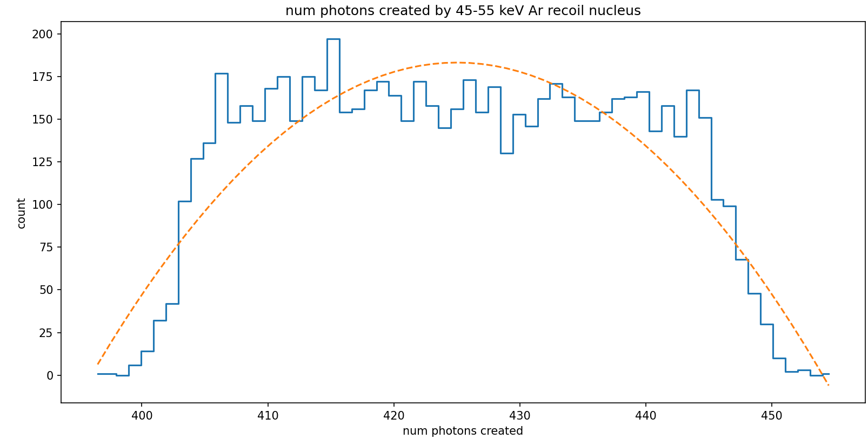
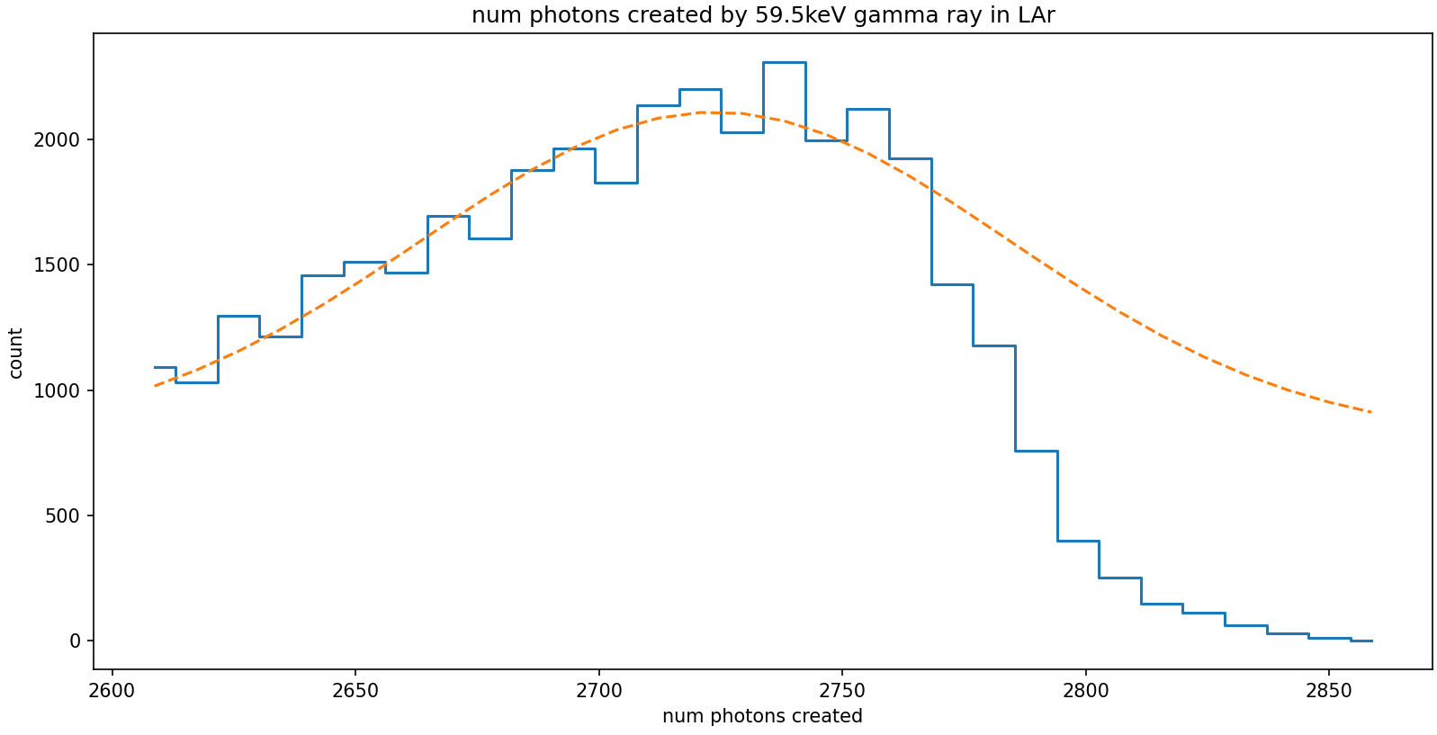

Slide 12
